Slide 1
Mora
Assignment 8: Hi-Fi Prototype
Bryant, Candy, Lulu, Tommy
11.22.2024

Slide 2




Our Team
Bryant
Candy
Lulu
Tommy
Senior
Computer Science
Senior
Urban Studies
Junior
Computer Science
Junior
Computer Science

Slide 3

more amusement. more acquisition. mora.

Slide 4
Problem
Solution
Traditional language learning methods use a one-size-fits-all curriculum that do not teach learners in fun and immersive contexts.
Mora is a streaming companion that interrupts your watching with live language lessons, curates personalized review material for your favorite shows, and connects you to interest-based communities of language learners to bond and/or compete live with.

Slide 5
Table of contents
01
Heuristic Evaluation Results
02
Design Revisions
03
Hi-Fi Status
04
Hi-Fi Demo
05
Appendix

Slide 6
01
Heuristic Evaluation Results

Slide 7
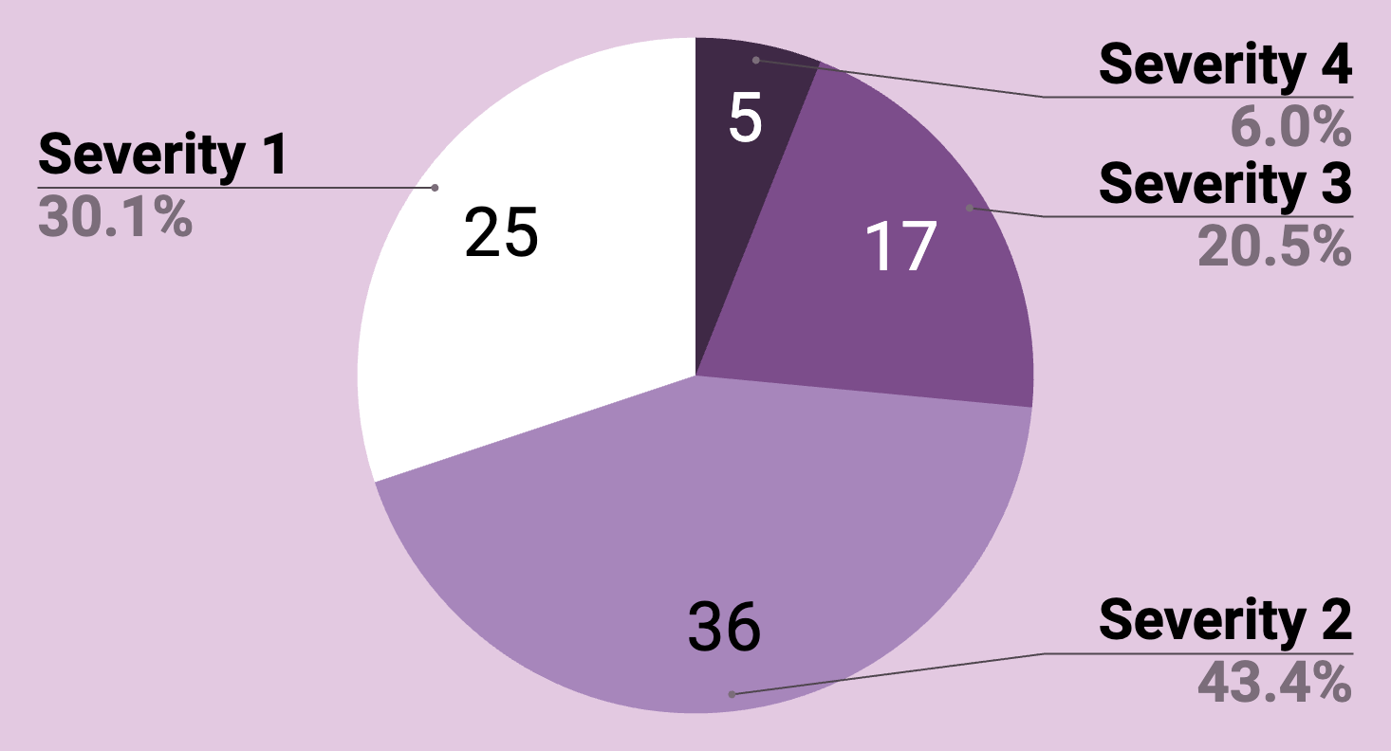
Violations Breakdown
Total # of Violations: 83
Notes:
About a quarter of violations are severity 3 and 4, the majority are severity 1 and 2

Slide 8
Most Common Violations
01
02
03
04
19%
13%
11%
11%
H4: Consistency & Standards
(16 violations)
H8: Aesthetic & Minimalist Design
(11 violations)
H1: Visibility of System Status
(9 violations)
H3: User Control & Freedom
(9 violations)

Slide 9
Violations by Task
Simple
Moderate
Complex
Misc.
23
19
22
19
Pair mechanism, watch session settings
Lesson & summary page content, filter mechanism
Visibility of settings, lack of context & explanation
Features not yet implemented
Notes:
We had 23 violations for our simple task focusing on pair mechanism and watch session settings
..

Slide 10
Qualitative Summary
Confusing use of action color
Lack of explanation & documentation throughout the app
Accessibility issues
Insufficient safeguards against mistaps
Unimplemented features
Notes:
To summarize the results, we received feedback about the confusing use of action color. The use of purple is not consistent. The use of grey is confusing. Onboarding is the only source of documentation and there’s no way to access that information again after onboarding. Small and low contrast. Not enough emergency exits/confirmation pages. Competitive feature isn’t fully fleshed out.

Slide 11
02
Design Revisions

Slide 12
16
Revisions
(+ 2 partial revisions)
22
severity 3 & 4 violations

Slide 13
Severity 3 & 4 Revisions Breakdown
Watch Party (5)
Lesson (3)
‘Add channels’ page (2)
Solo Watch Session Mechanism (2)
Filter (1.5)
Partial Revision: Organization of ‘your terms’ page
Acknowledgement of Language Levels (1.5)
Partial Revision: Added metric about skill level and progress
Profile page (1)
Contrast (1)
16
Revisions
(+ 2 partial revisions)
Notes:
Watch Party (5): Documentation of features and adding exits
Lesson (3): Content and layout
Add channels: Redesign to make navigation more intuitive
Solo Watch Session Mechanism (2): New pair button & revised pairing logic
RATIONALE FOR CHANGES: Significantly improves intuitive navigation of the app. Enhanced lesson content and more streamlined task flows help users be more engaged and interested.

Slide 14
What did we not change?
App expectation (4)
How pausing works (2)
Social expectation (2)
Rationale: Does not align with our app expectation & lack of explanation in README
4
No Revisions
Notes:
Feedback: User would have issues with the syncing between pausing TV and interacting with lesson content. Also there’s concerns about privacy with the social aspect.
The expectation is that Mora does the all the pausing for you for any lessons and quizzes. The user is not expected to do any syncing, they are only expected to engage with the lesson page. Emergency exit (bathroom breaks, etc) would be user manually pausing in the app where they’re watching

Slide 15
61
severity 1-2 violations
47
revisions

Slide 16
Severity 1 & 2 Breakdown
Consistency in alignment, spacing
Button placements
Hierarchy in colors, use of action color
Less crowded layouts
Nested information in information icons
Fleshed out logic for watch party function
Screens that clarify expectation and transition from previous screens
Documentation throughout app
47
revisions
Notes:
Rationale for changes: Really wanted to fix the visual inconsistencies for a cohesive UI. Having both good documentation and a fleshed out logic for a key feature is extremely important to help users interact with the app and retain their interest.

Slide 17
What did we not change?
Time constraint
Immediate feedback for more complex question types
Does not align with our expectation of the app
More emphasis on the social aspect than we intend
Excessive emergency exits and customization that could interrupt with task flow
11
No Revisions

Slide 18
Screen Revisions

Slide 19
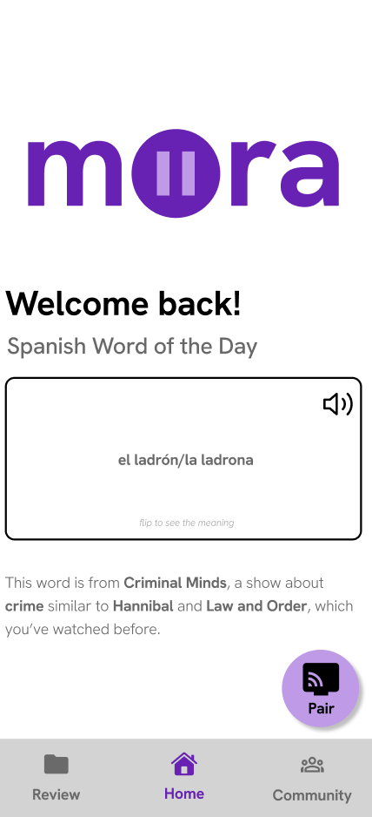
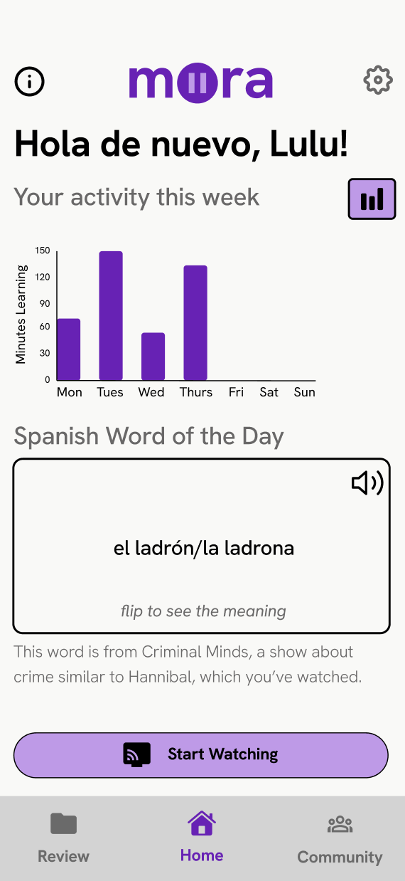
Home Screen
Organization
Statistics preview
Bigger font + higher contrast
Way to edit settings
Redesigned ‘pair’ button -> ‘start watching’ button
Visibility of system status

Slide 20
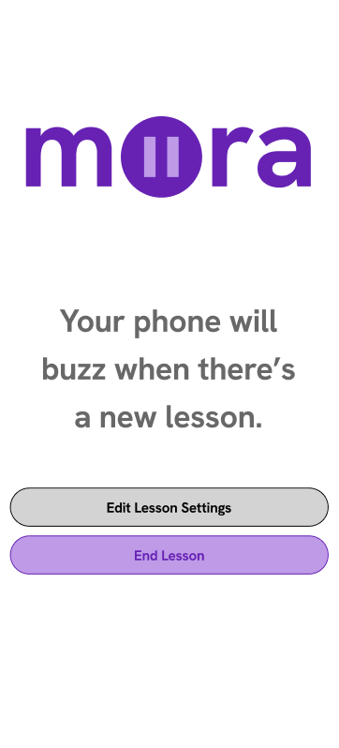
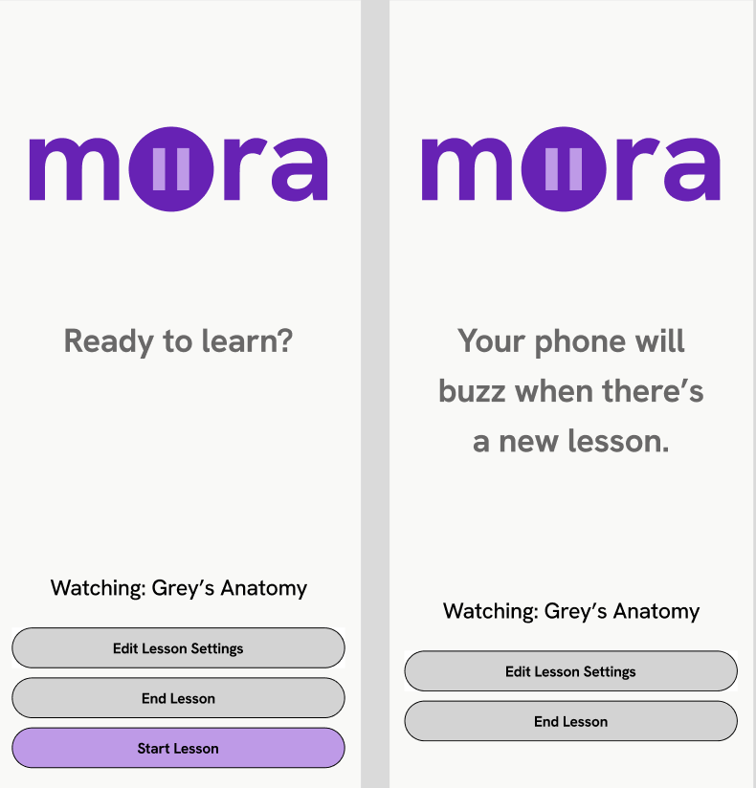
Simple Task Revision
Notes:
New screen that gives the user control to start lesson after the bluetooth pairing motion. Deemphasized the ‘end lesson’ button because it’s not the key action here.

Slide 21
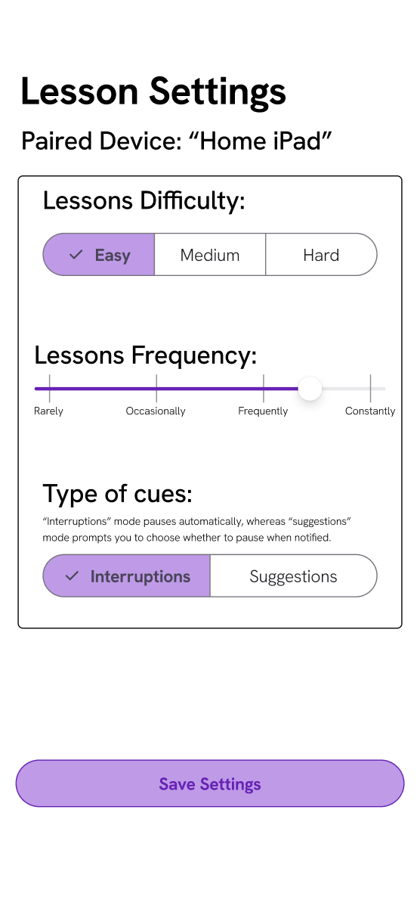
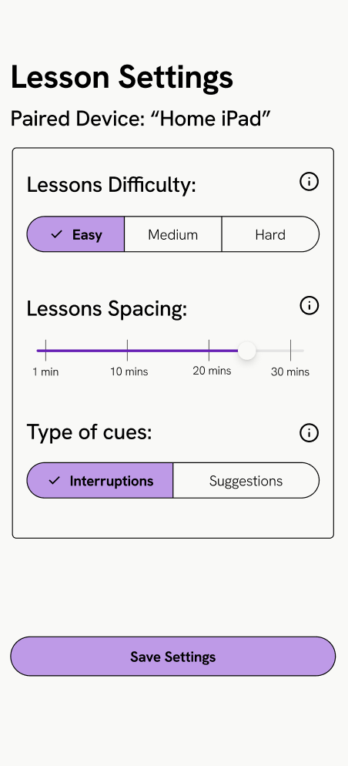
Simple Task Revision
Alignment
Slider labels
Default settings
Information icons about app-specific terminology
Contrast
Notes:
We fixed the alignment on this screen. Changed the slider labels and implemented the default settings for first use of the app. Subsequent uses will save the user’s settings automatically. Each setting also has information about it accessible via the info icon.

Slide 22
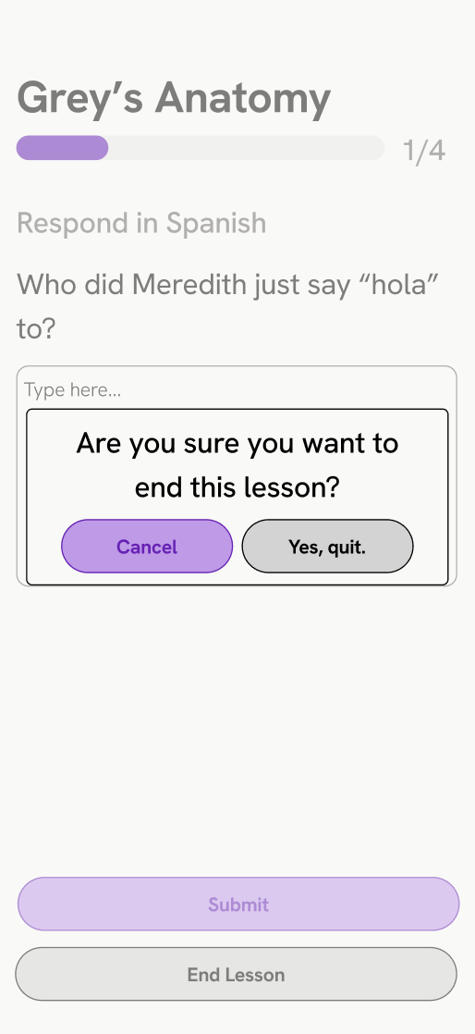
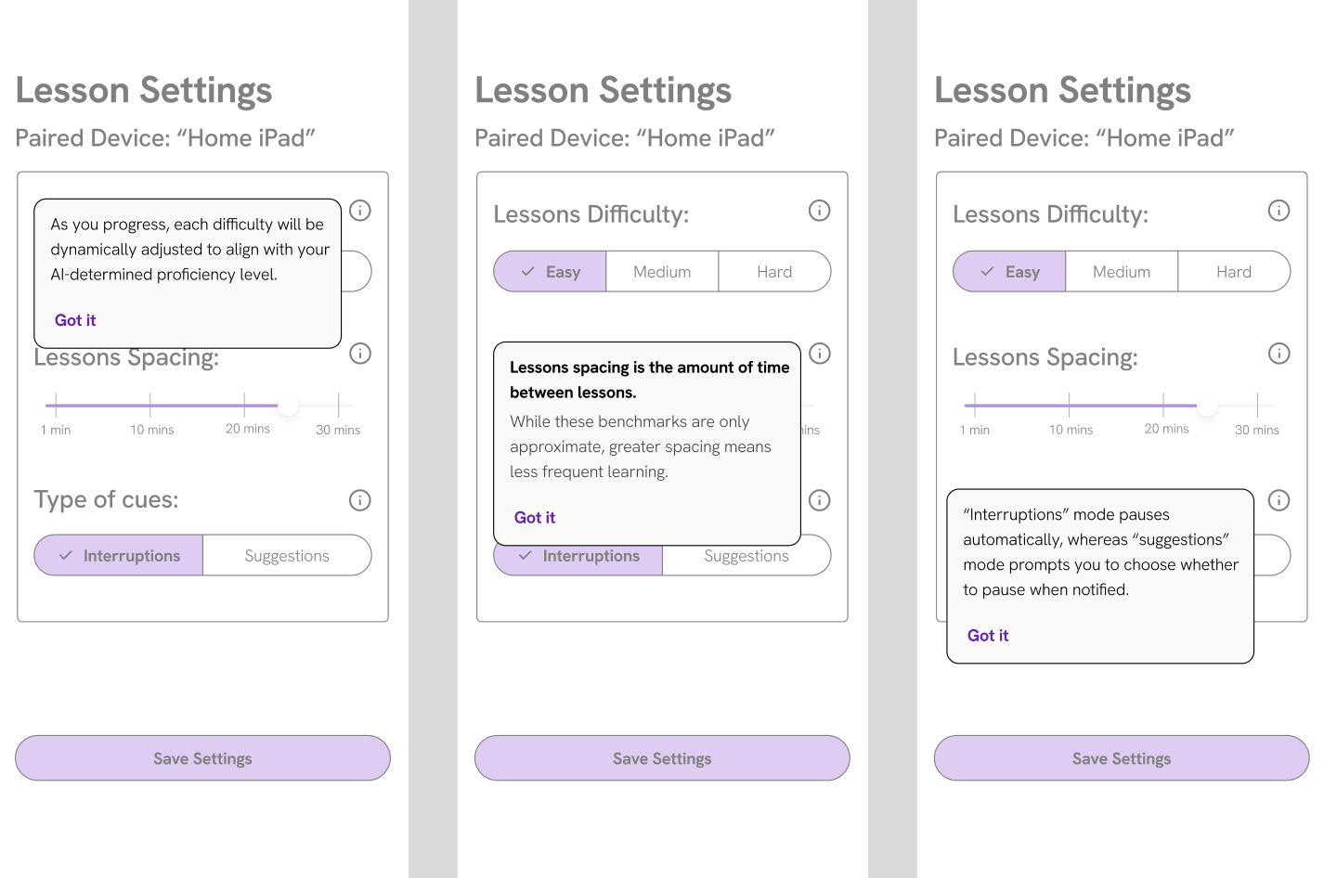
New Simple Task Screens
Notes:
We added a confirmation screen before ending the lesson and here are the specific messages that display when you click on the info icons.

Slide 23
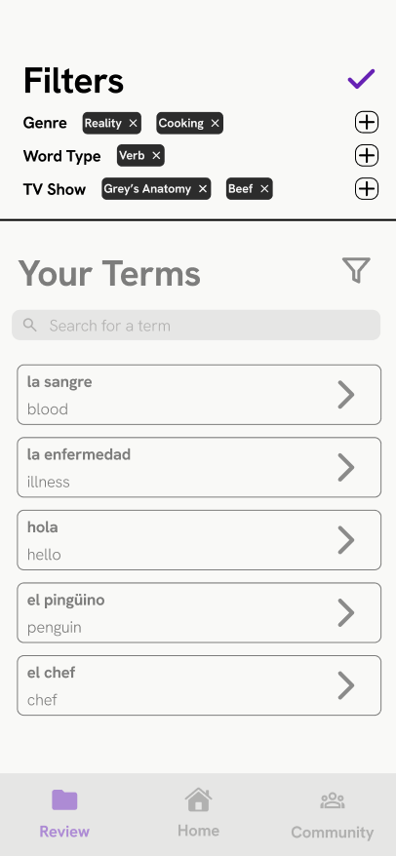
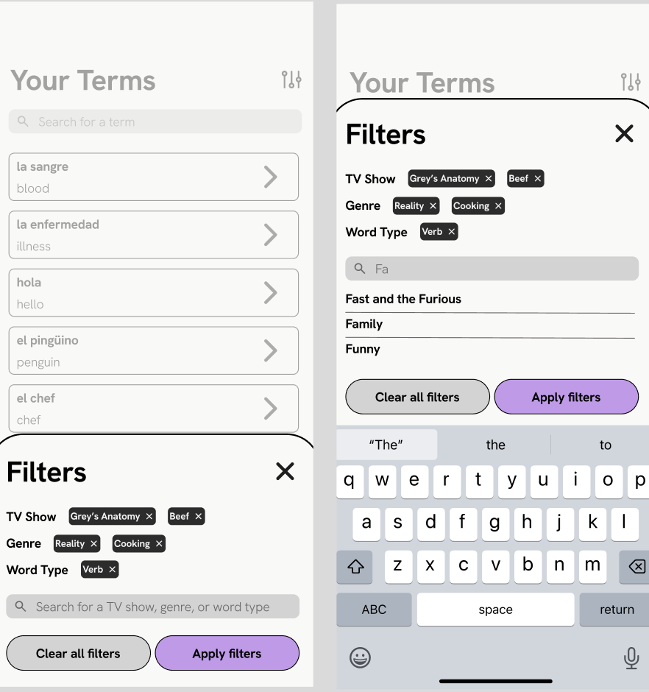
Moderate Task Revision
Notes:
We also completely redesigned the filter mechanism visually and functionally. By default, there is no organizing of terms. But users can optionally sort by different categories. We moved ‘TV show’ to the top to

Slide 24
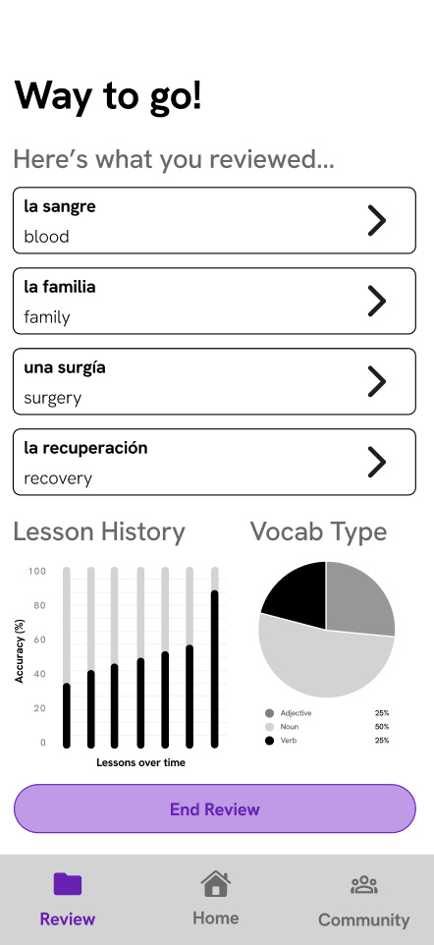
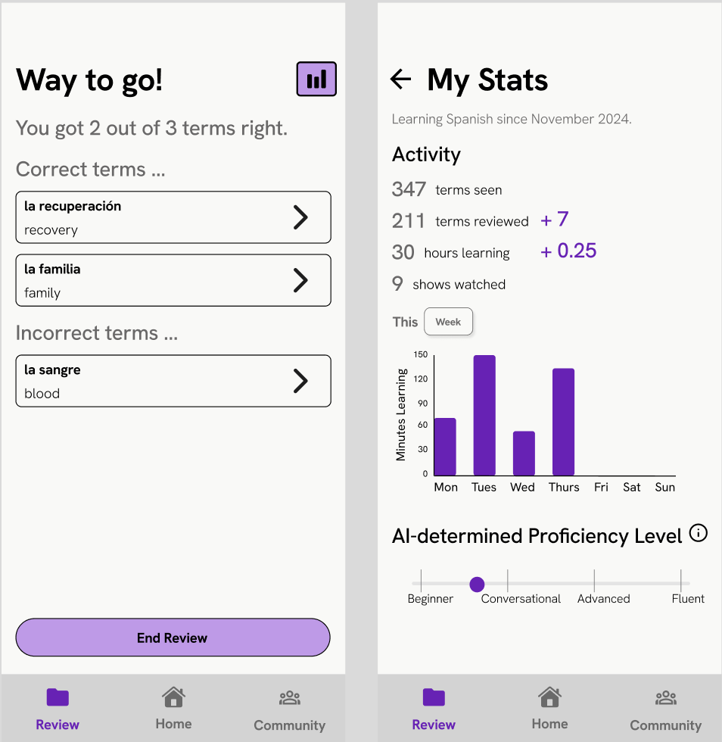
Moderate Task Revision

Slide 25
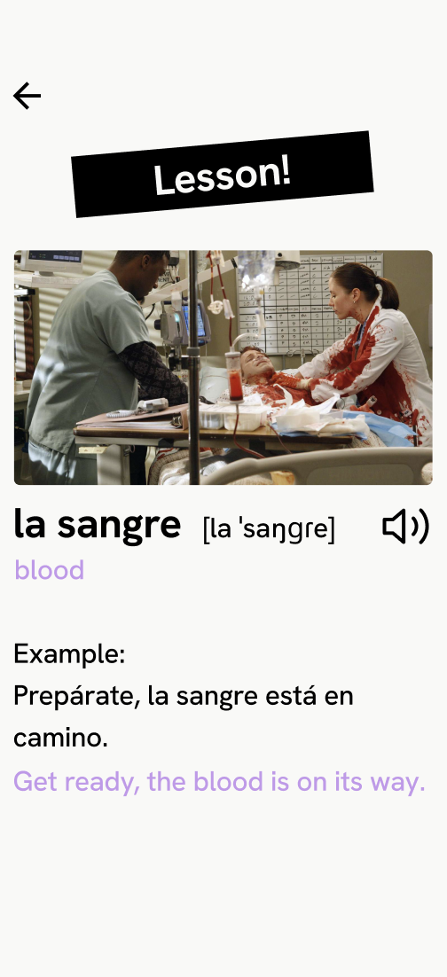
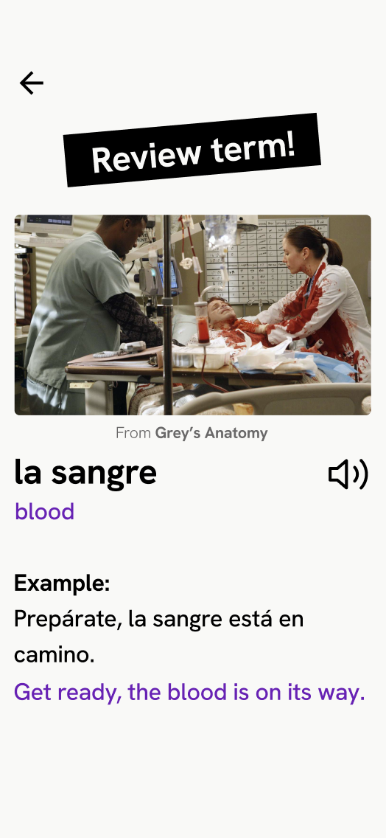
Moderate Task Revision
Better title
Description of show
Removed IPA transcription
Colors + hierarchy
Notes:
TODO

Slide 26
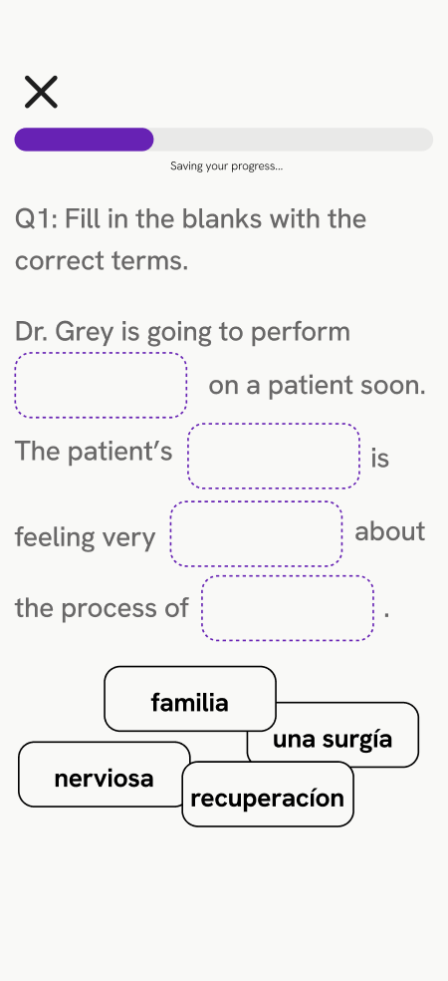
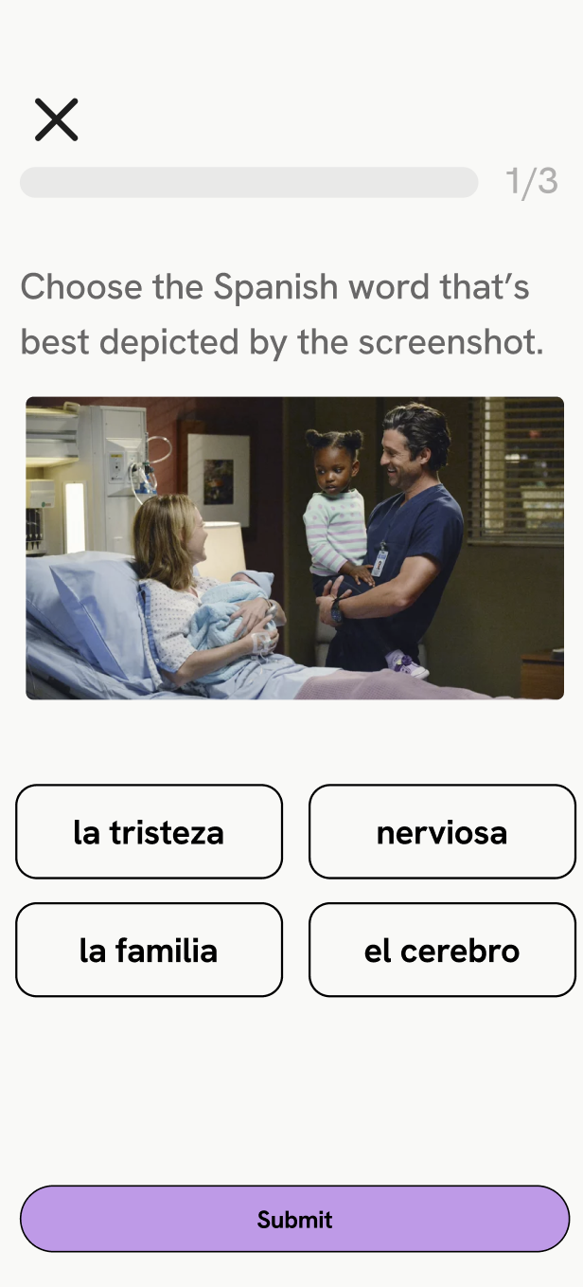
Moderate Task Revision
Notes:
New question type

Slide 27
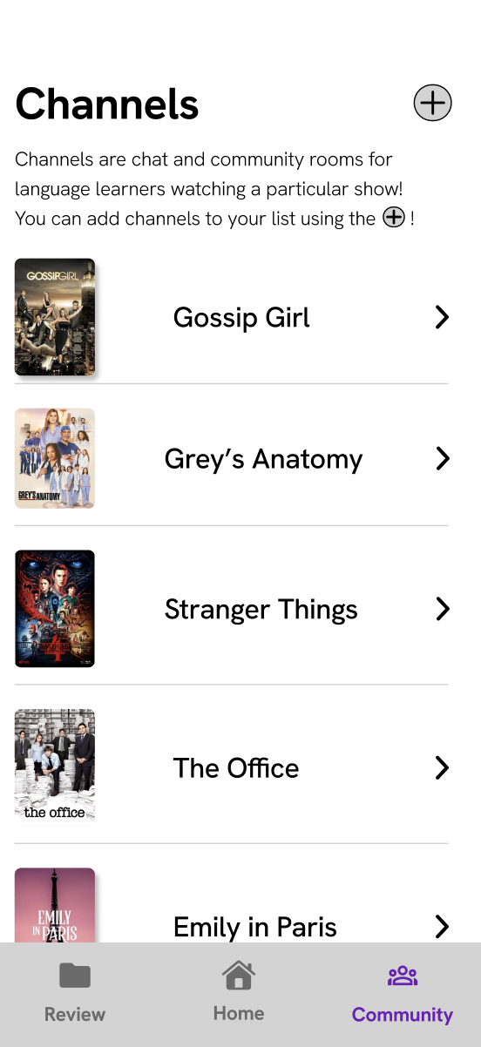
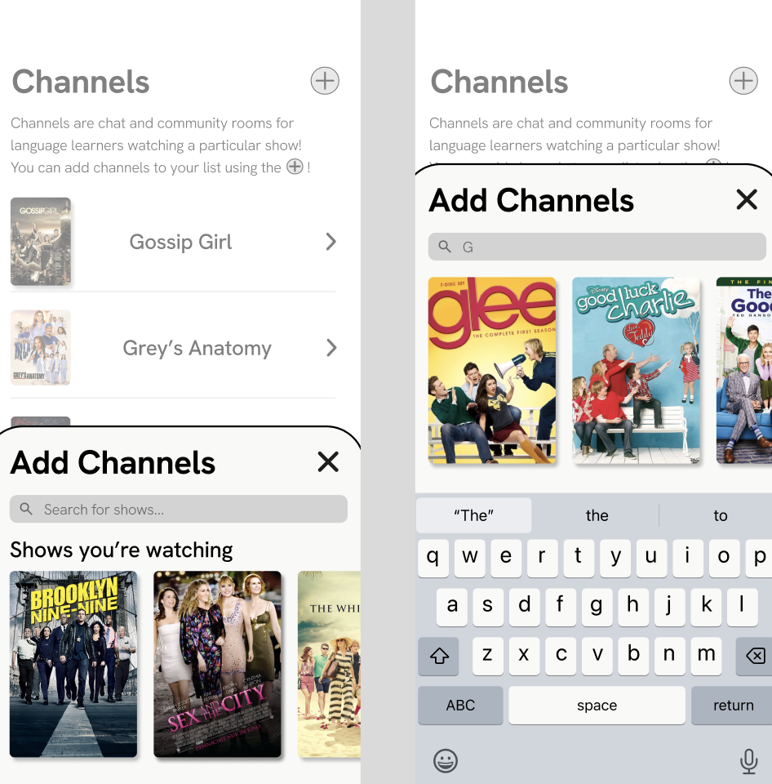
Complex Task Revision
Notes:
Flow revision

Slide 28
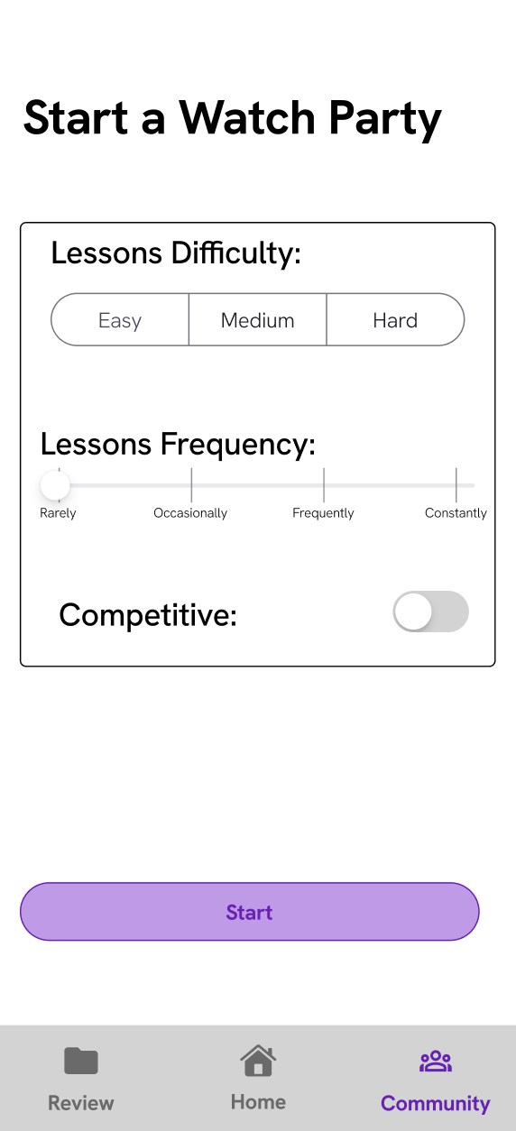
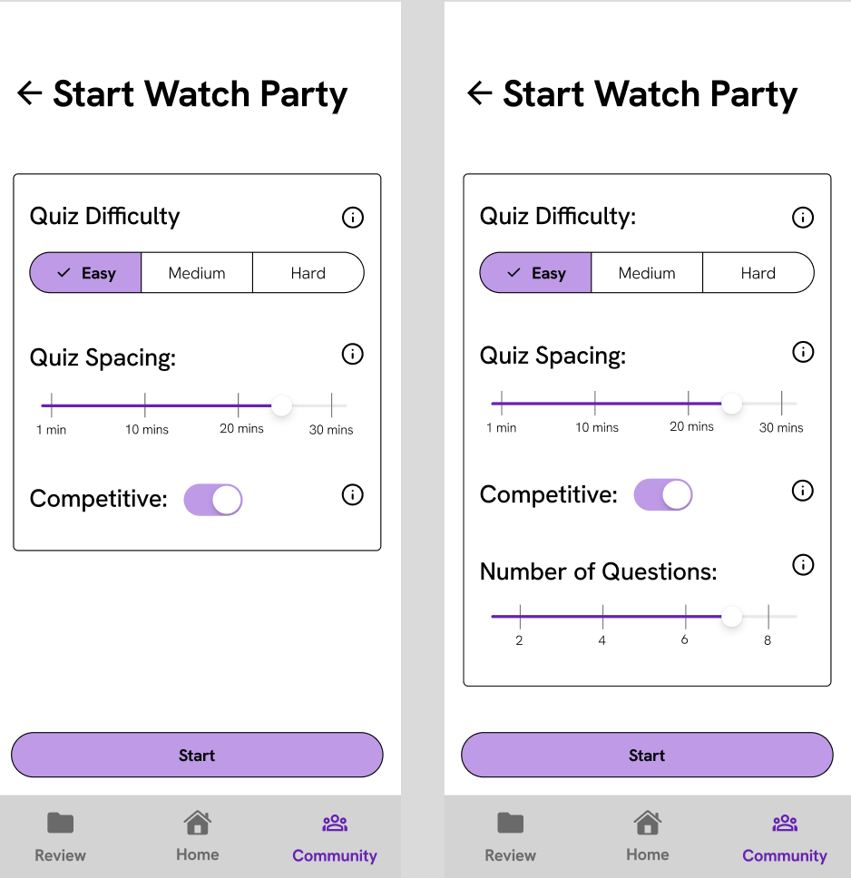
Complex Task Revision
Notes:
Flow revision

Slide 29
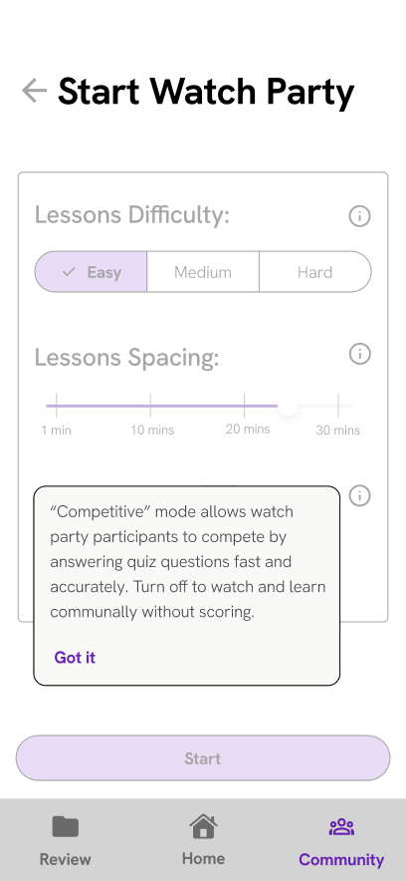
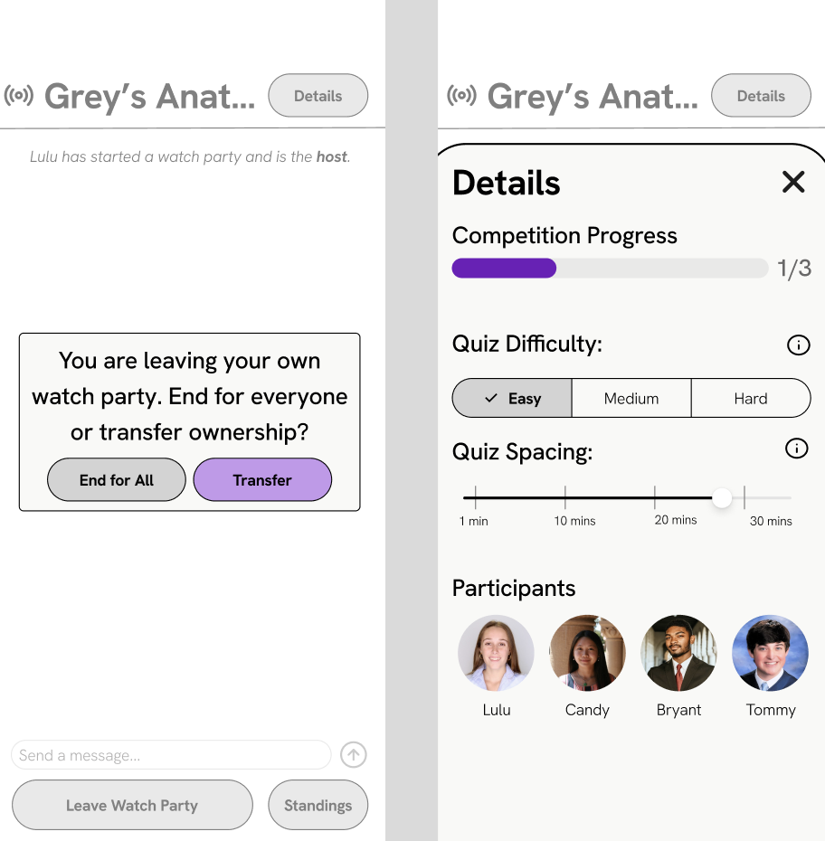
New Complex Task Screens
Notes:
New waiting screen

Slide 30
Fun
Eagerness
Intuitive
Usability Goals Progress
- More specific and granular statistics → excited, rewarding feeling
- Greater centered media in the review activity with new question type
- Made the simple task more flexible (can more easily end, etc.) so lower barrier to use
- Improved the home screen (i.e. added stats) to make it more engaging and enticing
- Buttons are more clearly distinguished and their icons more natural mappings
- Added many (i) icons to get help on app features where necessary

Slide 31
03
Hi-Fi Status

Slide 32


Our Tools
Notes:
TODO

Slide 33
Implemented features
Review task functionally complete!
3 different types of activities
Review term page
Scrollable list of terms
Filter terms by genre/TV show/word type
Navigation bar to move between main tasks
Stack navigation for the review activity
Notes:
TODO

Slide 34
Unimplemented features
Review task:
Confirmation screen for exiting
Stats page
Remove navigation bar from activities pages
Other:
Onboarding screens
Quiz/lesson screens
Chat (with an AI companion!)
Streaming settings
Competition mode
Notes:
TODO

Slide 35
Plans to finish
Thanksgiving break
Keep using our expo router structure to add more screens
Hardcode the lessons
Set up the AI chat
Notes:
TODO

Slide 36
Wizard of Oz Techniques
Pausing mechanism
“AI” - Determination of pauses, lesson content, skill level, progress
AI to allow users to “chat”
We are using these techniques to avoid actually connecting mora to a computer (complicated technology) and to not have to create a network of users for the chat (out of scope for this class).
Notes:
TODO

Slide 37
Hardcoded Data
User’s target language
List of words for review activity
Review activities (but you can actually get a score)
Available filters
Rationale: We have hardcoded this data to avoid having to use AI to generate personalized content and also to not have to rely on a user’s past streaming (data we don’t have).
Notes:
TODO

Slide 38
Issues/Questions
Biggest question: how will we “connect” mora to streaming?
Length of streaming experience
Super Wizard of Oz: give users a list of times to hit pause for hardcoded lesson
Most ideal: create a web app that mora can actually connect to
We are still figuring this out, and the decision will likely come down to how much time we have left after building everything else.

Slide 39
Plans to finish: Discussion
We feel really great about our progress so far
Definitely a learning curve working together at the beginning, but have gotten much faster over the course of the week
Looking forward to dedicating time to this over the break

Slide 40
04
Hi-Fi Demo

Slide 41
05
Appendix

Slide 42
Complete Violations Breakdown
Category | # of sev 1 | # of sev 2 | # of sev 3 | # of sev 4 | # total
H1: Visibility of System Status | 3 | 3 | 3 | 0 | 9
H2: Match b/w System & World | 4 | 1 | 1 | 1 | 7
H3: User Control & Freedom | 0 | 5 | 2 | 1 | 8
H4: Consistency & Standards | 6 | 8 | 2 | 0 | 16
H5: Error Prevention | 1 | 2 | 1 | 2 | 6
H6: Recognition not Recall | 1 | 1 | 2 | 0 | 4
H7: Flexibility & Efficiency of Use | 4 | 3 | 0 | 0 | 7
H8: Aesthetic & Minimalist Design | 5 | 5 | 1 | 0 | 11
H9: Help Users with Errors | 0 | 2 | 0 | 0 | 2
H10: Help & Documentation | 0 | 2 | 3 | 1 | 6
H11: Accessible Design | 0 | 3 | 1 | 0 | 4
H12: Value Alignment & Inclusion | 1 | 1 | 1 | 0 | 3
Total Violations | 25 | 36 | 17 | 5 | 83

Slide 43
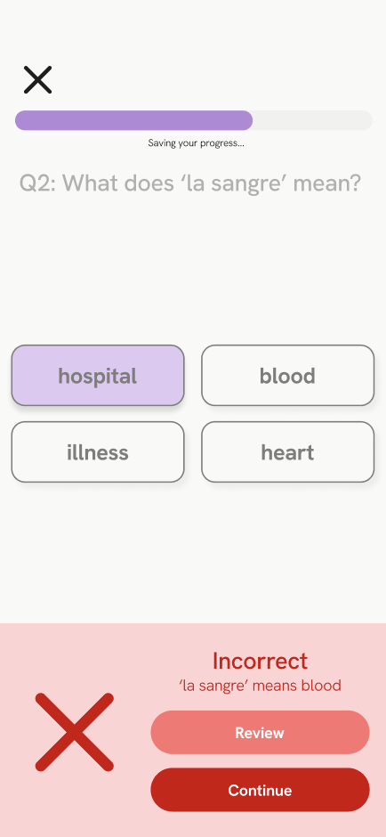
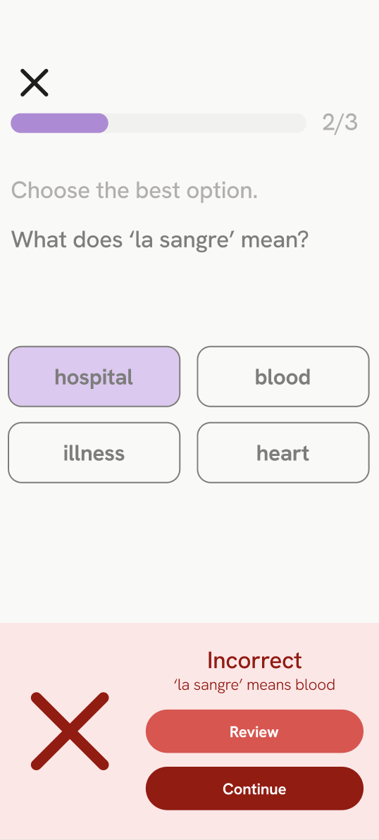
Question Revision
Higher contrast
Removed ‘saving your progress’
Removed drop shadow
Notes:
New waiting screen

Slide 44
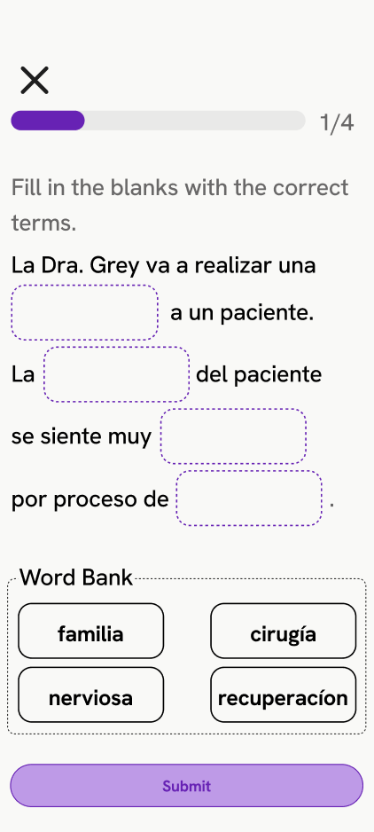
Moderate Task Revision (before scrapped)
System status
Submit button
Organization
Lesson content
Contrast
Scrapped because we wanted to utilize show content more effectively in questions + cannot implement feasibly in React Native.

Slide 45
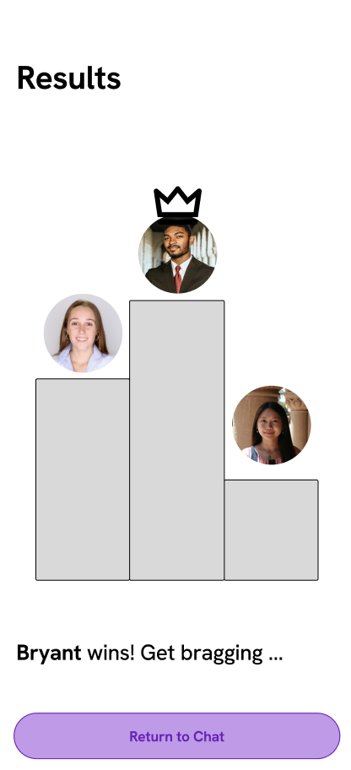
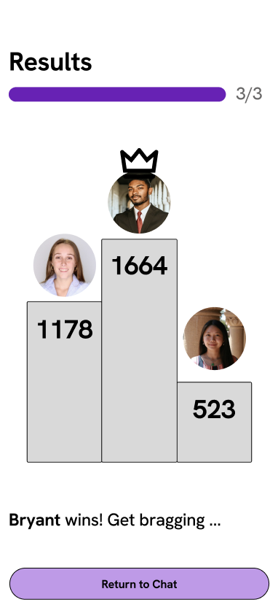
Question Revision
Higher contrast
Moved progress bar
Added scores to bars
Notes:
New waiting screen

Slide 46
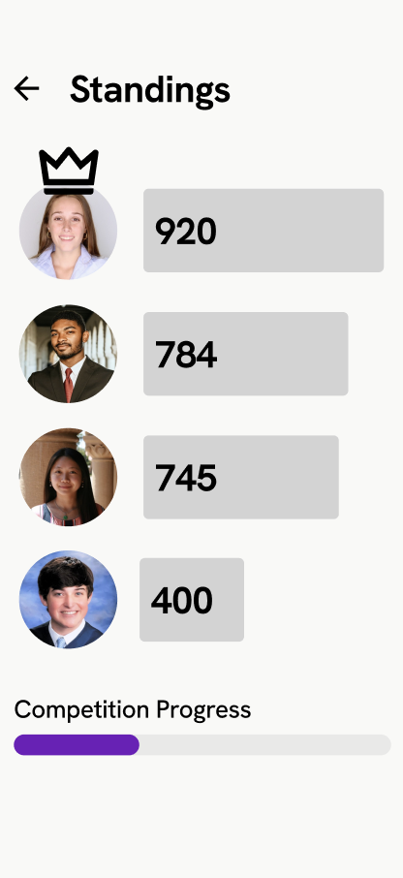
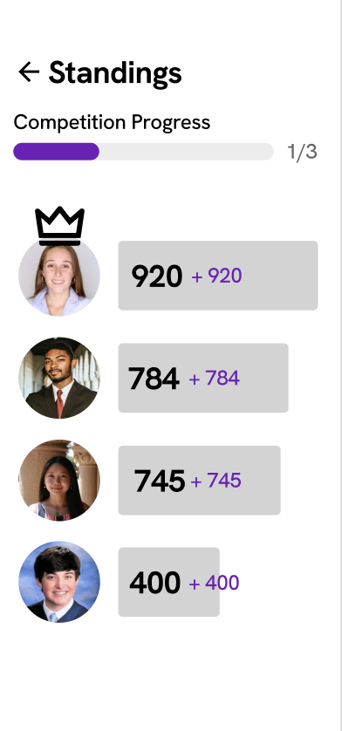
Question Revision
Moved progress bar
Added addition of scores to each bar to show results after each question
Notes:
New waiting screen

